Slide 1
Service Delivery Management

Slide 2
The team
2200033020 – N. Mugdha Mohana 2200030751 – Ch. Nikhila 2200033002 – P. Pujitha

Slide 3
Contents of our project
Problem Statement
Abstract
Introduction
Analysis of Charts and Graphs from Survey
Customer Journey Map
User Persona
Empathy Map
Modules
Linkedin profile
Conclusion

Slide 4
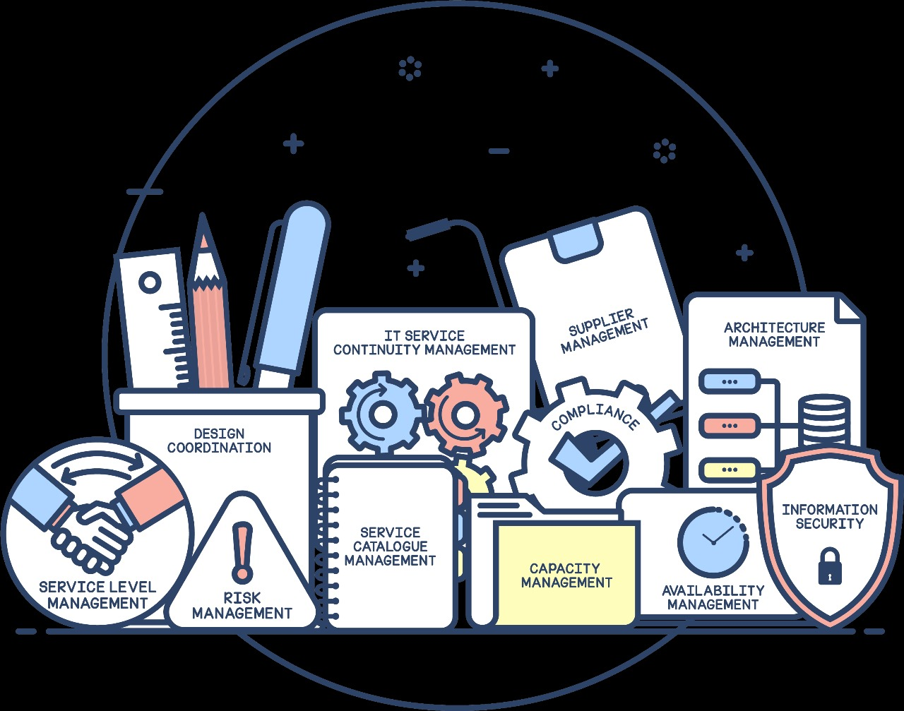
Problem statement
Problem Statement to Develop a web-based application that is a user-friendly, serving as a centralized platform to help individuals and teams organize, track, and prioritize services and projects .

Slide 5
Abstract
This Project relies on Service Management System. Online Service Management System is an Electronics and Electrical service workshop offering an outsized array of services. We concentrate on enhancing our user experience by applying world-class Electronic Appliances maintenance services. Our main goal is to form customers proud of services. With well-equipped Electronic Appliances service centers and fully trained mechanics, we offer quality services with a superb package designed to supply you with excellent savings. Today customers want services at their place because of COVID-19. Luckily, today we've got the technology for providing services online. And it all begins with Online Service Management System. Keywords: Request, Services, Appliances, Online, Quality

Slide 6
Introduction
Service Management is an Electronics and Electrical service workshop offering a good array of services. We concentrate on enhancing your uses experience by applying world-class Electronic Appliances maintenance services. Our sole mission is to provide Electronic Appliances care services to keep the devices fit and healthy and customers happy and smiling. Suppose someone wants aid for major tasks; the difficulty arises when service skilled persons are unavailable. Trusted providers are impossible to search out, who delivers consistently flawless services instantly. Our system describes booking in-house professionals and gets your service done on time. Today’s customers expect prime quality and excellent service at a better price. Luckily, today we all know much more about a way to provide people with the experience they need. And it all begins with Online Service Management System.

Slide 7
Service delivery responsibilities
Service delivery
Meeting support
Technical service
Performance
Mercury is the closest planet to the Sun
Venus is the second planet from the Sun
Jupiter is a gas giant and the biggest planet of them all
Despite being red, Mars is a very cold place

Slide 8
Service delivery manager skills
Support software
ITIL disciplines
Planning skills
Venus is the second planet from the Sun but it’s very hot
Mercury is the closest planet to the Sun and the smallest planet
Mars is actually a very cold place. It’s also full of iron oxide dust

Slide 9
Business IT support services
Network efficiency
Cyber security
Mercury is the closest planet to the Sun and is also the smallest one
Venus has a beautiful name and is the second planet from the Sun

Slide 10
Customer engagement
User feedback
Surveys
Satisfaction
How to engage customers with workshops:
1
2
3
Neptune is far away from Earth
Jupiter is the biggest planet of them all
Mercury is the smallest planet

Slide 11
Steps for effective delivery of IT services
Stakeholders
Business services
Enterprise
Work plan
Measures
Improvement
Neptune is far away from Earth
Venus is the second planet from the Sun
Saturn is a gas giant and has several rings
Despite being red, Mars is a very cold place
Mercury is the closest planet to the Sun
Jupiter is the biggest planet of them all

Slide 12
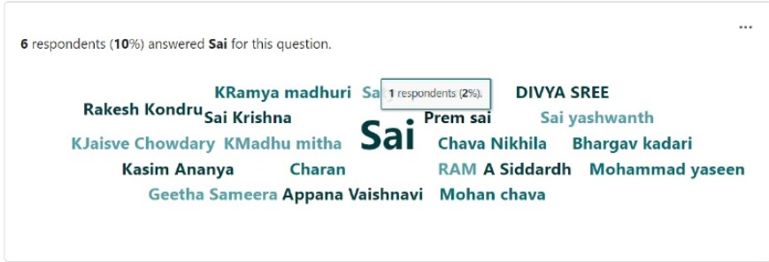
Analysis of Charts and Graphs from Survey

Slide 13
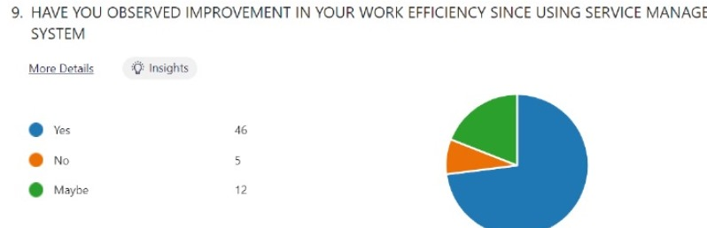

Slide 14
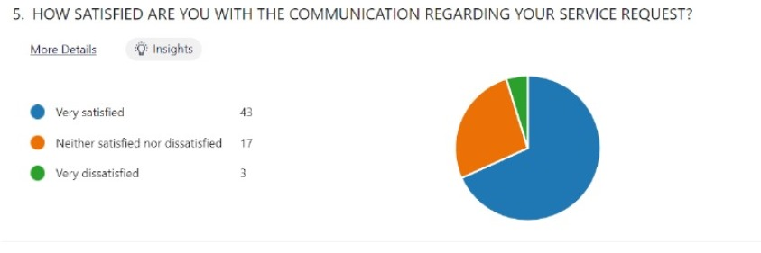

Slide 15
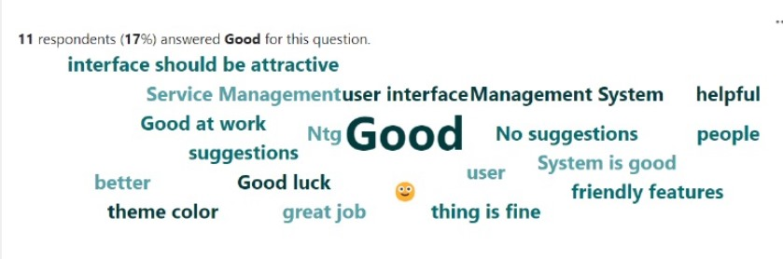

Slide 16
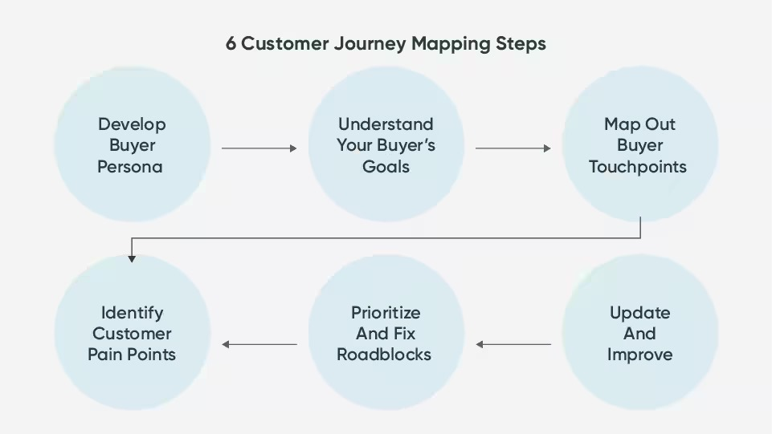
Customer Journey Map

Slide 17

User Persona
Name : P. Venkateswarulu
Age : 67
Gender : Male

Slide 18
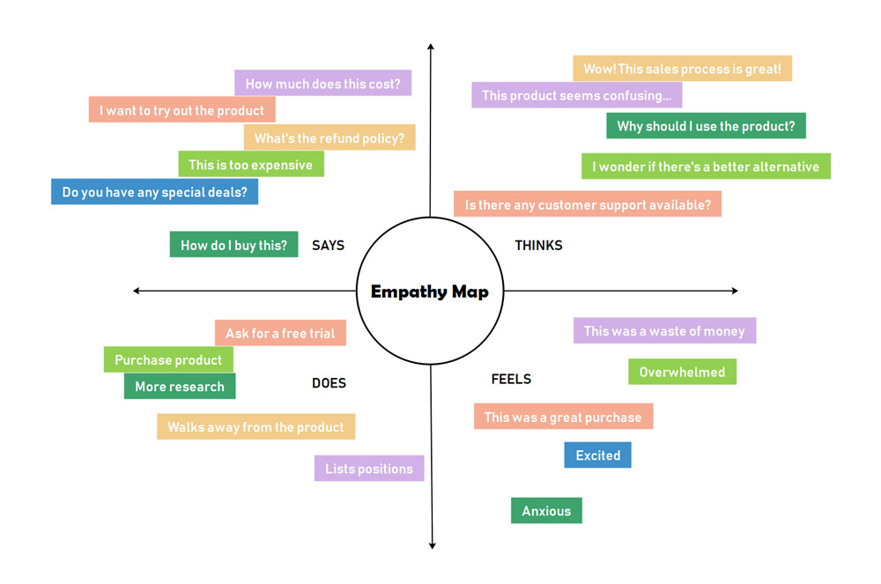
Empathy Map

Slide 19
Modules
Share fie
Get file
Dashboard
My files i.eRecently shared files

Slide 20
Conclusion
In conclusion, service management systems play a pivotal role in ensuring the efficient delivery of services, whether in healthcare, IT, hospitality, or any other industry. By implementing robust systems like ITIL, COBIT, or Six Sigma, organizations can streamline processes, improve service quality, and enhance customer satisfaction. These systems provide frameworks for effective resource allocation, problem resolution, and continual improvement, ultimately leading to greater operational efficiency and competitive advantage. Embracing service management best practices not only fosters organizational success but also cultivates a culture of service excellence. As businesses continue to evolve in a dynamic market environment, the adoption of service management systems will remain essential for staying agile, responsive, and customer-focused."

Slide 21
Linkedin Profile
https://www.linkedin.com/pulse/copy-service-management-system-mugdha-mohana-nimmala-w0gre/

Slide 22

Thanks!

